Slide 1
Unsupervised Learning-Cluster Analysis
Notes:
1

Slide 2
Chapter 10. Cluster Analysis: Basic Concepts and Methods
Types of data in cluster analysis
Cluster Analysis: Basic Concepts
Partitioning Methods
Hierarchical Methods
Evaluation of Clustering
Summary
2
2
Notes:
2

Slide 3
What is Cluster Analysis?
Unsupervised learning:
no predefined classes
(i.e., learning by observations vs. learning by examples: supervised)
Typical applications
As a stand-alone tool to get insight into data distribution

Slide 4
Applications of Cluster Analysis
Data reduction
Compression: Image processing: vector quantization
Prediction based on groups
Cluster & find characteristics/patterns for each group
Finding K-nearest Neighbors
Localizing search to one or a small number of clusters
Outlier detection: Outliers are often viewed as those “far away” from any cluster

Slide 5
Quality: What Is Good Clustering?
A good clustering method will produce high quality clusters
high intra-class similarity: cohesive within clusters
low inter-class similarity: distinctive between clusters
The quality of a clustering method depends on
the similarity measure used by the method
its implementation, and
Its ability to discover some or all of the hidden patterns

Slide 6
Major Clustering Approaches (I)
Partitioning approach:
Construct various partitions and then evaluate them by some criterion, e.g., minimizing the sum of square errors
Typical methods: k-means, k-medoids
Most are distance based… iterative relocation technique ie improve partitioning by moving objects from one group to another
Hierarchical approach:
Create a hierarchical decomposition of the set of data (or objects) using some criterion
Typical methods: Agnes (agglomerative), Diana (Divisive)

Slide 7
Cluster Analysis: Basic Concepts and Methods
Cluster Analysis: Basic Concepts
Partitioning Methods
Hierarchical Methods
7
7
Notes:
7

Slide 8
Partitioning Algorithms: Basic Concept
Partitioning a database D of n objects into a set of k clusters, such that the sum of squared distances is minimized
where
E is sum of squared distances
d is distance;
p is a data point;
c_{i} is the centroid or medoid of cluster C_{i})

Slide 9
Partitioning Algorithms: Basic Concept
Given k, find a partition of k clusters that optimizes the chosen partitioning criterion
Global optimal: exhaustively enumerate all partitions
Heuristic methods: k-means and k-medoids algorithms
k-means (MacQueen’67, Lloyd’57/’82): Each cluster is represented by the center of the cluster
k-medoids or PAM (Partition around medoids) (Kaufman & Rousseeuw’87): Each cluster is represented by one of the objects in the cluster

Slide 10
The K-Means Clustering Method
Given k, the k-means algorithm is implemented in four steps:
Partition objects into k nonempty subsets
Compute seed points as the centroids of the clusters of the current partitioning (the centroid is the center, i.e., mean point, of the cluster)
Assign each object to the cluster with the nearest seed point
Go back to Step 2, stop when the assignment does not change

Slide 11
An Example of K-Means Clustering
K=2
Arbitrarily partition objects into k groups
Update the cluster centroids
The initial data set
Loop if needed
Reassign objects
Algorithm
Partition objects into k nonempty subsets
Repeat
Compute centroid (i.e., mean point) for each partition
Assign each object to the cluster of its nearest centroid
Until no change
Update the cluster centroids

Slide 12
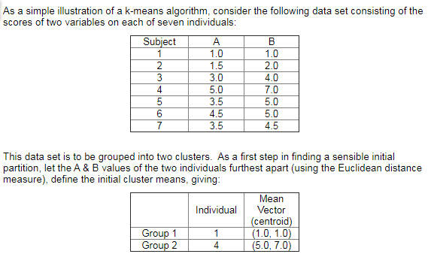
K-Means Cluster

Slide 13
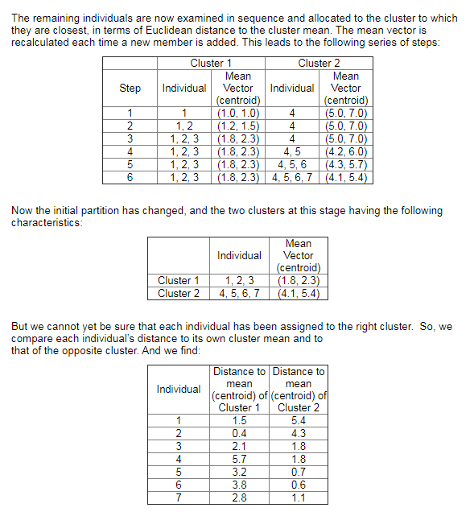
K-Means Cluster

Slide 14
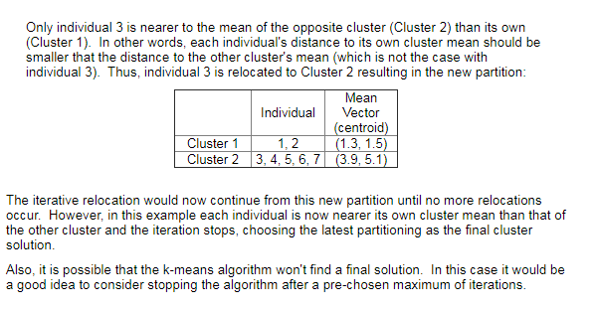
K-Means Cluster

Slide 15
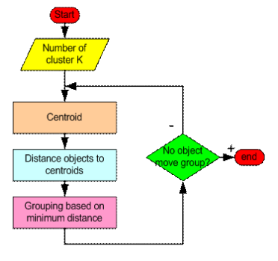
K-Means Cluster

Slide 16
Determine the Number of Clusters
Empirical method
# of clusters ≈√n/2 for a dataset of n points ( 10 for n=200)
Elbow method
Cross validation method
16

Slide 18
Determine the Number of Clusters
2. Elbow method
Use the turning point in the curve of sum of within cluster variance w.r.t the # of clusters
Within cluster variance
k

Slide 19
Comments on the K-Means Method
Strength:
Efficient:
Comment: Often terminates at a local optimal
Weakness
Applicable only to objects in a continuous n-dimensional space
Using the k-modes method for categorical data
In comparison, k-medoids can be applied to a wide range of data
Need to specify k, the number of clusters, in advance (there are ways to automatically determine the best k (see Hastie et al., 2009)
Sensitive to noisy data and outliers
Not suitable to discover clusters with non-convex shapes

Slide 20
What Is the Problem of the K-Means Method?
The k-means algorithm is sensitive to outliers !
Since an object with an extremely large value may substantially distort the distribution of the data
K-Medoids: Instead of taking the mean value of the object in a cluster as a reference point, medoids can be used, which is the most centrally located object in a cluster
10
10
9
9
8
8
7
7
6
6
5
5
4
4
3
3
2
2
1
1
0
0
1
2
3
4
5
6
7
8
9
10
0
0
1
2
3
4
5
6
7
8
9
10

Slide 21
PAM: A Typical K-Medoids Algorithm
Total Cost = 20
10
9
8
Arbitrary choose k object as initial medoids
Assign each remaining object to nearest medoids
7
6
5
4
3
2
1
0
0
1
2
3
4
5
6
7
8
9
10
K=2
Randomly select a nonmedoid object,O_{ramdom}
Total Cost = 26
Do loop
Until no change
10
10
9
Compute total cost of swapping
9
Swapping O and O_{ramdom}
If quality is improved.
8
8
7
7
6
6
5
5
4
4
3
3
2
2
1
1
0
0
1
2
3
4
5
6
7
8
9
10
0
0
1
2
3
4
5
6
7
8
9
10
21
Notes:
21

Slide 22
Cluster Analysis: Basic Concepts and Methods
Cluster Analysis: Basic Concepts
Partitioning Methods
Hierarchical Methods
Evaluation of Clustering
Summary
22
22
Notes:
22

Slide 23
Distance between Clusters
X
X
Single link: smallest distance between an element in one cluster and an element in the other, i.e., dist(K_{i}, K_{j}) = min(t_{ip}, t_{jq})
Complete link: largest distance between an element in one cluster and an element in the other, i.e., dist(K_{i}, K_{j}) = max(t_{ip}, t_{jq})
Centroid: distance between the centroids of two clusters, i.e., dist(K_{i}, K_{j}) = dist(C_{i}, C_{j})
Medoid: distance between the medoids of two clusters, i.e., dist(K_{i}, K_{j}) = dist(M_{i}, M_{j})
Medoid: a chosen, centrally located object in the cluster
23
Notes:
23

Slide 24
Hierarchical Clustering
Use distance matrix as clustering criteria. This method does not require the number of clusters k as an input, but needs a termination condition
Step 0
Step 1
Step 2
Step 3
Step 4
agglomerative
(AGNES)
a
a b
b
a b c d e
c
c d e
d
d e
e
divisive
(DIANA)
Step 4
Step 3
Step 2
Step 1
Step 0

Slide 25
AGNES (Agglomerative Nesting)
Use the single-link method and the dissimilarity matrix
Merge nodes that have the least dissimilarity
Go on in a non-descending fashion
Eventually all nodes belong to the same cluster

Slide 26
Dendrogram: Shows How Clusters are Merged
Decompose data objects into a several levels of nested partitioning (tree of clusters), called a dendrogram
A clustering of the data objects is obtained by cutting the dendrogram at the desired level, then each connected component forms a cluster

Slide 27
Cluster Analysis: Basic Concepts and Methods
Cluster Analysis: Basic Concepts
Partitioning Methods
Hierarchical Methods
Clustering Tendency-Hopkin’s Test
Evaluation of Clustering
Summary
27
27
Notes:
27

Slide 28
Assessing Clustering Tendency
Clustering tendency assessment determines whether a given data set has a non-random structure, which may lead to meaningful clusters.
Consider a data set that does not have any non-random structure, such as a set of uniformly distributed points in a data space.
Even though a clustering algorithm may return clusters for the data, those clusters are random and are not meaningful

Slide 29
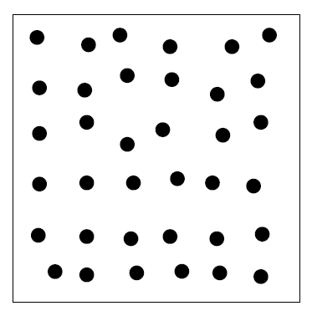
Assessing Clustering Tendency
Points uniformly distributed in 2-D data space.
Although a clustering algorithm may still artificially partition the points into groups, the groups will unlikely mean anything significant to the application due to the uniform distribution of the data.

Slide 30
How can we assess the clustering tendency of a data set?”
Intuitively,
measure the probability that the data set is generated by a uniform data distribution….
use statistical tests for spatial randomness.
A simple yet effective statistic called the Hopkins Statistic.
The Hopkins Statistic is
a spatial statistic that
tests the spatial randomness of a variable as distributed in a space.

Slide 31
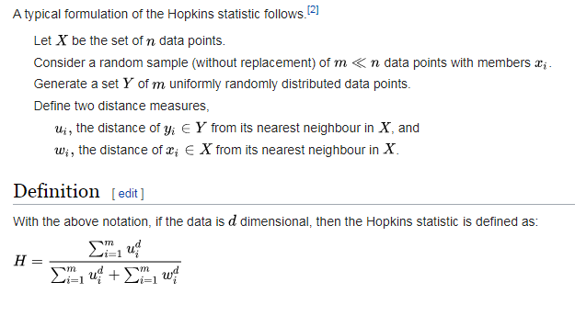
Hopkins statistic

Slide 32
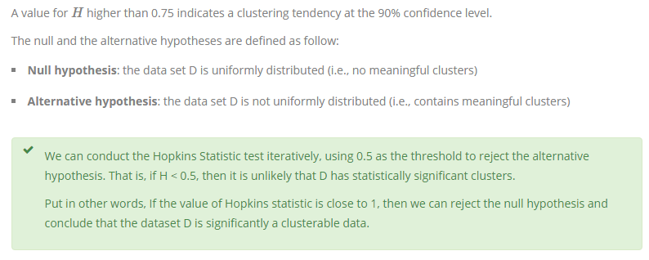
Hopkins statistic

Slide 33
Cluster Analysis: Basic Concepts and Methods
Cluster Analysis: Basic Concepts
Partitioning Methods
Hierarchical Methods
Evaluation of Clustering
Summary
33
33
Notes:
33

Slide 34
Measuring Clustering Quality
Two methods: extrinsic vs. intrinsic
Extrinsic: supervised, i.e., the ground truth is available
Compare a clustering against the ground truth using certain clustering quality measure
Ex. BCubed precision and recall metrics
Intrinsic: unsupervised, i.e., ground truth is not available
Evaluate the goodness of a clustering by considering
how well the clusters are separated, and
how compact the clusters are
Ex. Silhouette coefficient
34

Slide 35
Intrinsic Methods

Slide 36
Intrinsic Methods When the ground truth of a data set is not available
Evaluate a clustering by examining how
well the clusters are separated and
compact the clusters are.
Silhouette coefficient
For a data set, D, of n objects, suppose D is partitioned into k clusters, C1, : : : ,Ck.
For each object o in D, calculate
a(o) as the average distance between o and all other objects in the cluster to which o belongs.
Similarly, b(o) is the minimum average distance from o to all clusters to which o does not belong.
Average: avg distance between an element in one cluster and an element in the other, i.e., dist(K_{i}, K_{j}) = avg(t_{ip}, t_{jq})

Slide 37
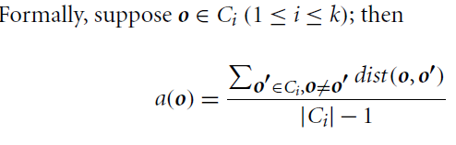
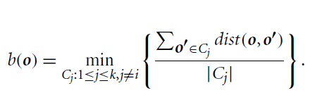
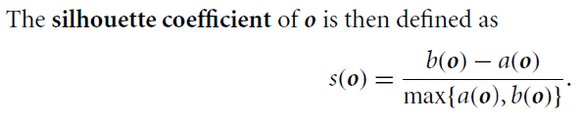
Silhouette coefficient
a(o) as the average distance between o and all other objects in the cluster to which o belongs.
Similarly, b(o) is the minimum average distance from o to all clusters to which o does not belong.

Slide 38
Silhouette coefficient
The value of the silhouette coefficient is between -1 and 1.
a(o) reflects the compactness of the cluster to which o belongs. The smaller the value, the more compact the cluster.
b(o) captures the degree to which o is separated from other clusters. The larger b(o) is, the more separated o is from other clusters.
Therefore, when the silhouette coefficient value of o approaches 1, the cluster containing o is compact and o is far away from other clusters, which is the preferable case.
However, when the silhouette coefficient value is negative (i.e., b(o) < a(o)), this means that, in expectation, o is closer to the objects in another cluster than to the objects in the same cluster as o. …i.e., In many cases, this is a bad situation and should be avoided.

Slide 39
Silhouette coefficient
To measure a cluster’s fitness within a clustering, compute the average silhouette coefficient value of all objects in the cluster.
To measure the quality of a clustering, use the average silhouette coefficient value of all objects in the data set.
The silhouette coefficient and other intrinsic measures can also be used in the elbow method…to heuristically derive the number of clusters in a data set by replacing the sum of within-cluster variances.

Slide 40
Extrinsic Methods

Slide 41
BCubed precision and recall
BCubed evaluates the precision and recall for every object in a clustering on a given data set according to ground truth.
The precision of an object: how many other objects in the same cluster belong to the same category as the object.
The recall of an object: reflects how many objects of the same category are assigned to the same cluster.

